Slide 1


Microsoft Exploratory Film Insights
By JOE GARCIA

Slide 2

Microsoft Exploratory Film Insights
We will make recommendations for Microsoft's new film studio.
We'll consider the type of movie, the budget, and how the audience will rate the movie.
We will then analyze the given data sets and explore what are the ultimate avenues to take.

Slide 3

What type of films to create?
The film industry has a lot of pitfalls. Particularly those that involve money. To guide your decisions into this perilous industry we can answer a few basic questions:
What are the major traits per movie that they should follow?
How do we know how much is too much and just the right amount to budget.
How does the public receive the movies?

Slide 4



Film Data
Data used was from
IMDB
Rotten Tomatoes
Box Office Mojo
We will take a glance at how much money a movie has made domestically, at the production value, and finally at the rating.

Slide 5
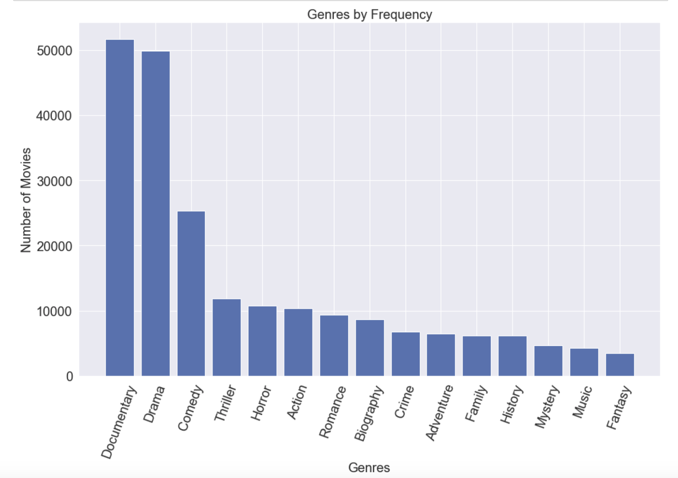

Slide 6


ROI stands for Return On Invest
DOMESTIC RETURN ON INVESTMENT (ROI)
=
DOMESTIC GROSS
PRODUCTION BUDGET

Slide 7
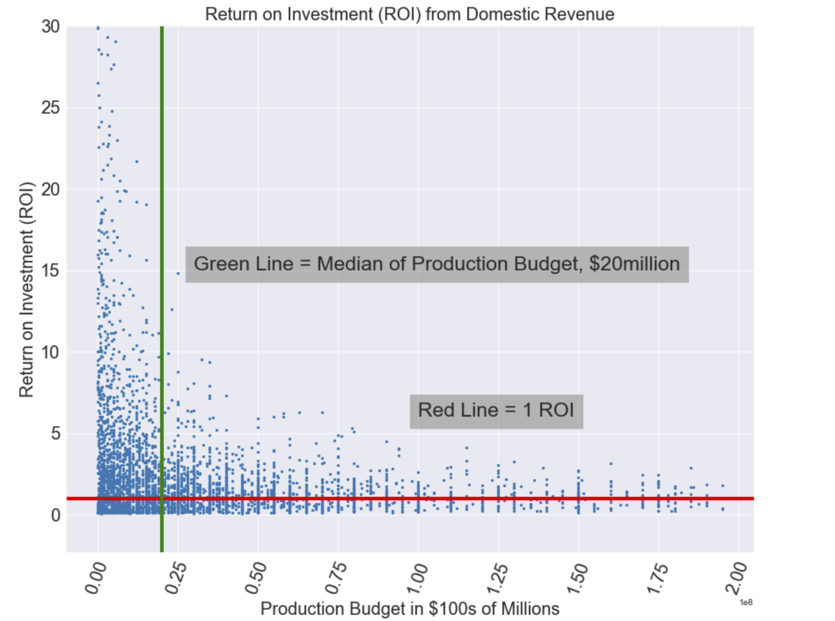

Slide 8
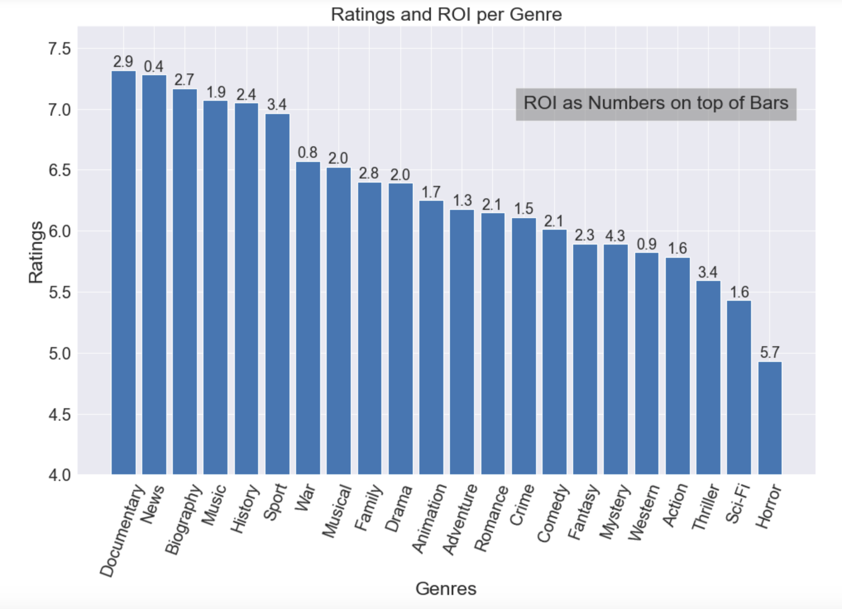

Slide 9

Conclusions
The movie should have a few elements of Drama, Comedy, or Documentary.
Movies such as Documentary, News, Biography are generally rated highly as opposed to Horror which is more lucrative.
Movies that have a lower or medium budget have a higher chance to have more ROI.

Slide 10
Thank You!
Email: Garcia.i.joe88@email.com
GitHub: @Foxxenn
LinkedIn: linkedin.com/in/joe-g-84633239/

